Slide 1
What Is The State of Food Security and Nutrition in the US?
A Graphical Story by Umer Farooq

Slide 2
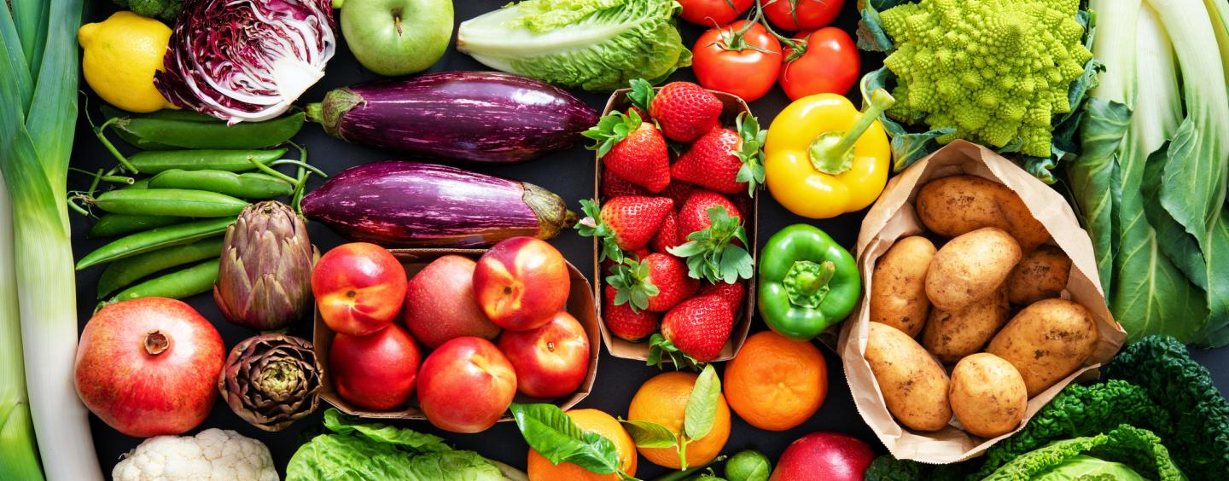

Food Insecurity and Nutrition in USA
The United Nations Food and Agriculture Organization publication, The State of Food Security and Nutrition in the World 2022 (https://www.fao.org/documents/card/en/c/cc0639en) might lead one to the conclusion that it's an elsewhere problem. That the people who are suffering malnutrition and starvation are "elsewhere", not in our backyard. In this story we are taking a closer look here at home (the US). Below are some points that needs to be considered before looking at the story:
All the data used for each visualization is from the year 2020-21.
Majority of people confuses food insufficiency (hunger or scarcity) with food insecurity
Food insecurity here means food with low quality nutrition.
All the data is about food insecurity

Slide 3
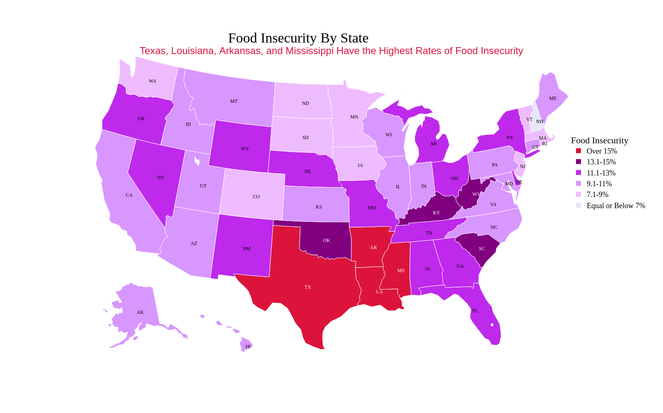
How Much Food Insecure US Is By Each State

Slide 4
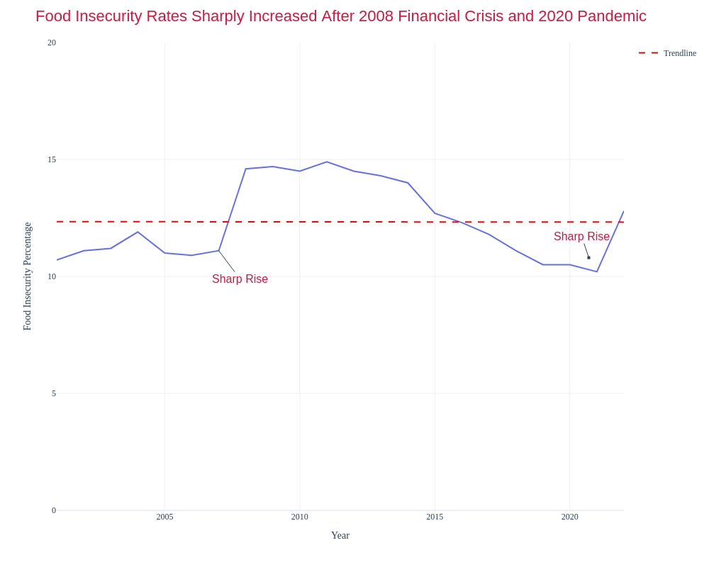
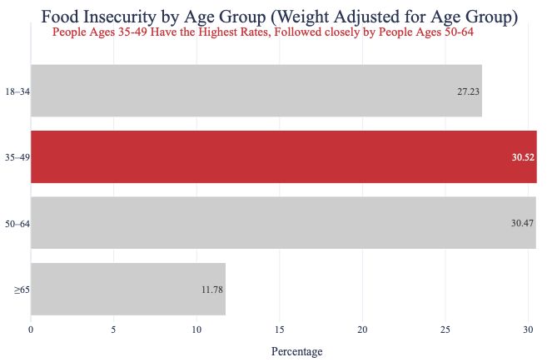
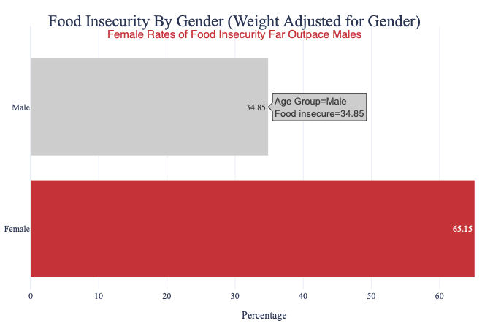
What Is The Trend Of Food Insecurity And How Much US Is Food Insecure By Age Group And Gender?

Slide 5
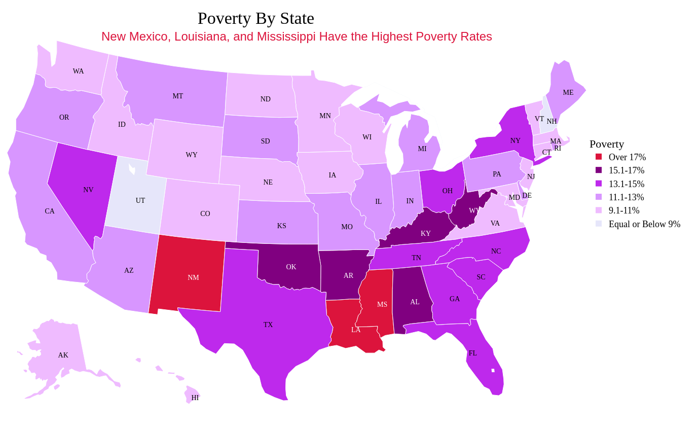
Does Food Insecurity Correlates Poverty?

Slide 6
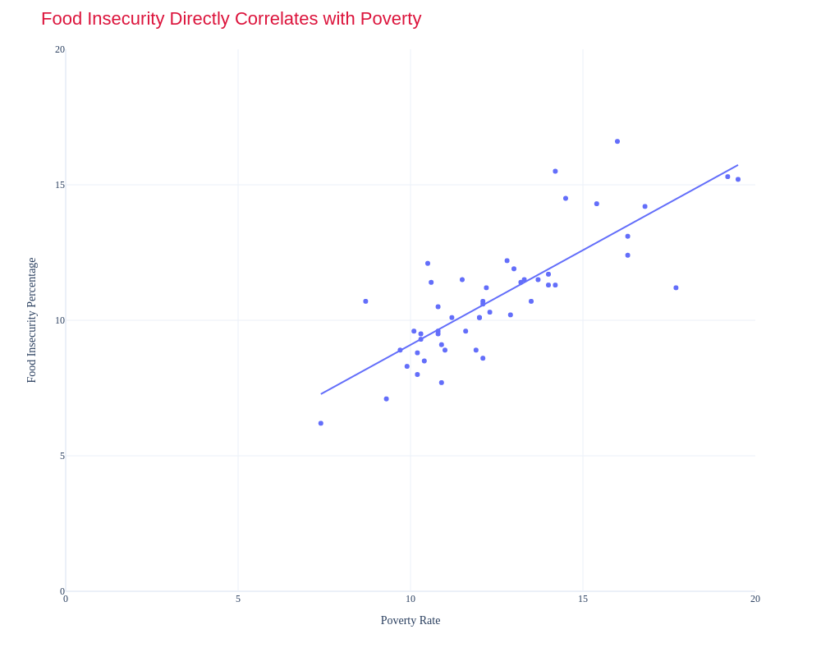
Does Food Insecurity Correlates Poverty?

Slide 7
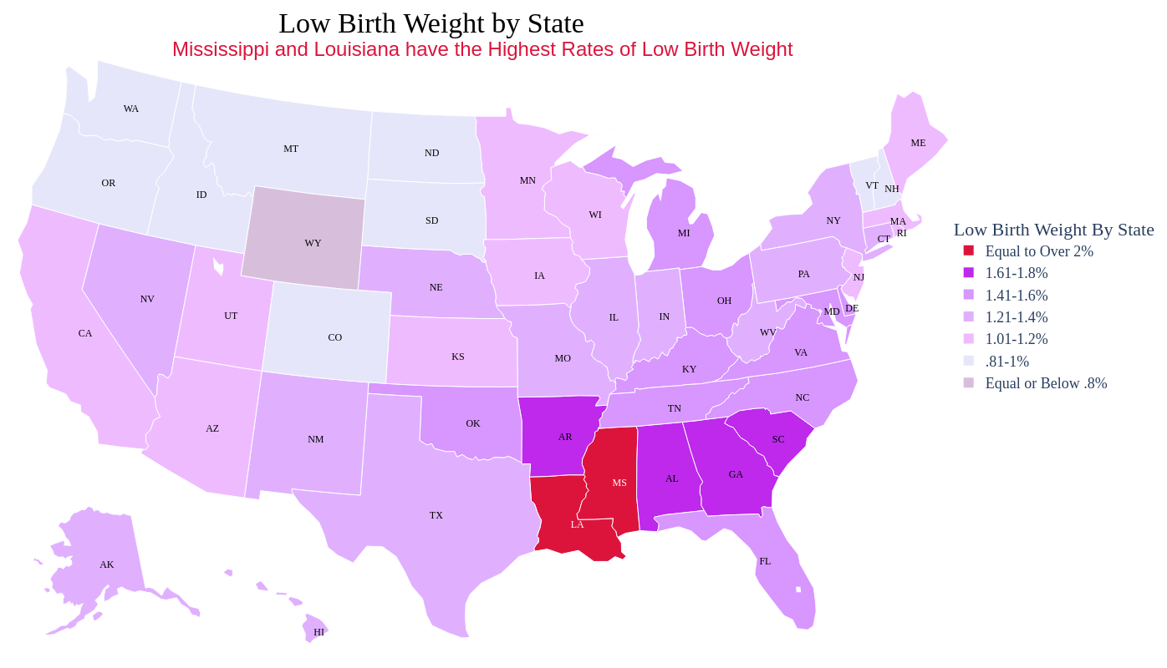
What Does Food Insecurity Causes?
Low birth weight has been experienced in States which has relatively higher food insecurity

Slide 8
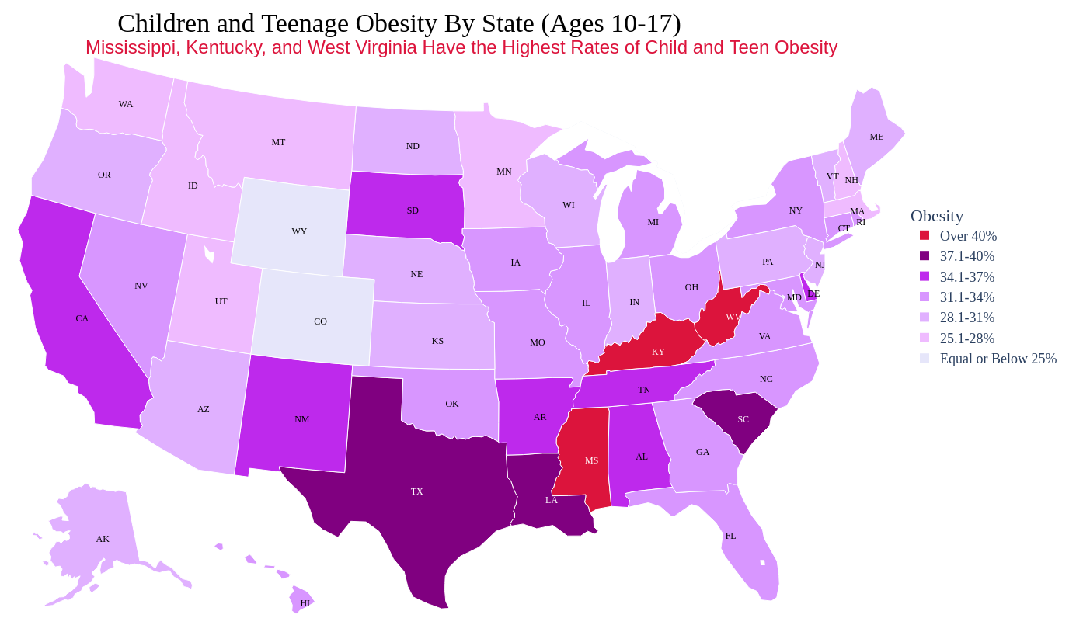
What Does Food Insecurity Causes?
Higher obesity rates in child and teen has been experienced in States which has relatively higher food insecurity

Slide 9
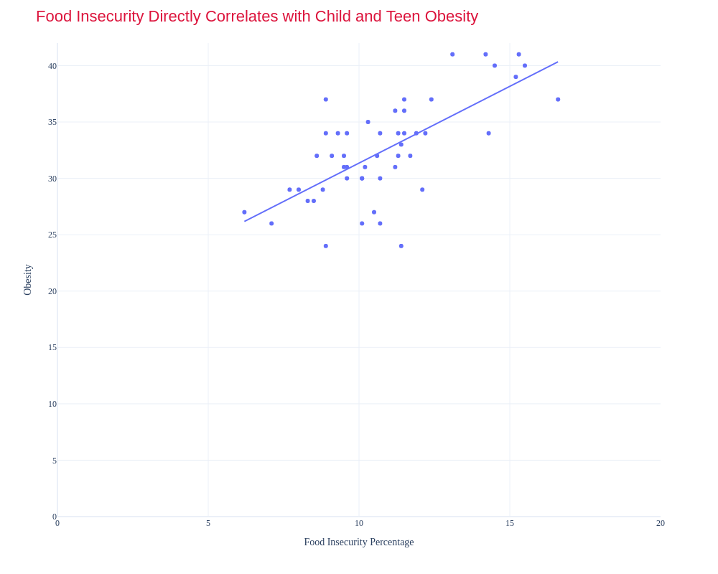
Does Food Insecurity Correlates Child and Teen Obesity?

Slide 10
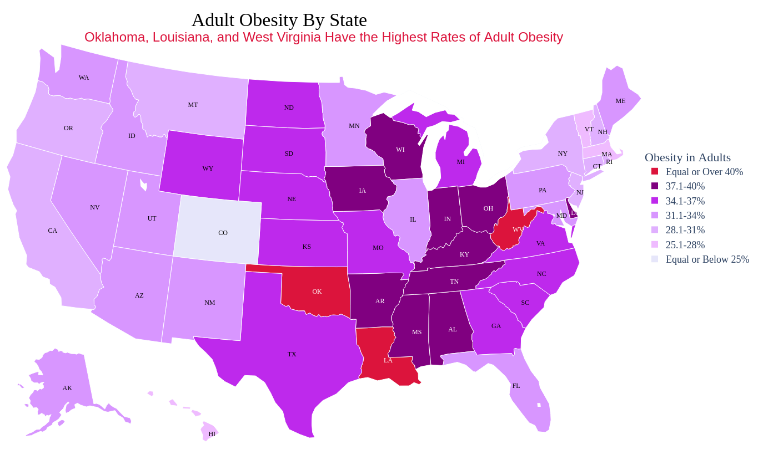
What Does Food Insecurity Causes?
Higher obesity rates in adults has been experienced in States which has relatively higher food insecurity

Slide 11
References:
•https://www.cdc.gov/obesity/data/prevalence-maps.html#overall
•https://www.census.gov/data/tables/2023/demo/hhp/hhp63.html
•https://datacenter.aecf.org/data/tables/9700-children-and-teens-overweight-or-obese-by-gender?loc=1&loct=2#detailed/2/2-52/false/2043,1769,1696,1648,1603/16,14,15/18944
•https://data.ers.usda.gov/reports.aspx?ID=17826
•https://www.ers.usda.gov/topics/food-nutrition-assistance/food-security-in-the-u-s/key-statistics-graphics/#foodsecure

